Slide 1

CIST 2931, Fall 2016 Weekly Report #7 11/14/2016
i c i o u s
Cnrl/alt/Delicious
Steven Alcorn, Zachary Weaver, Tyrus Skipper, Antonio Mosquera, Rupa Shrestha

Slide 2
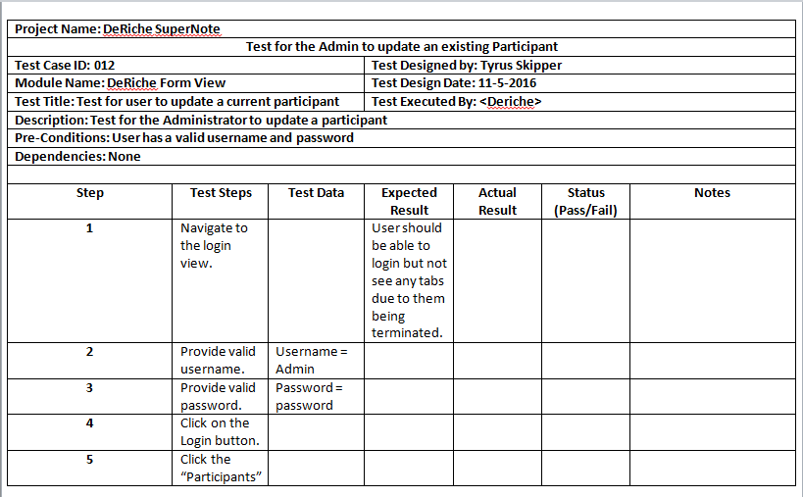
Tests
i c i o u s
Continue writing Test Scripts for the user to use once a deliverable is ready for them.
Notes:
Antonio

Slide 3
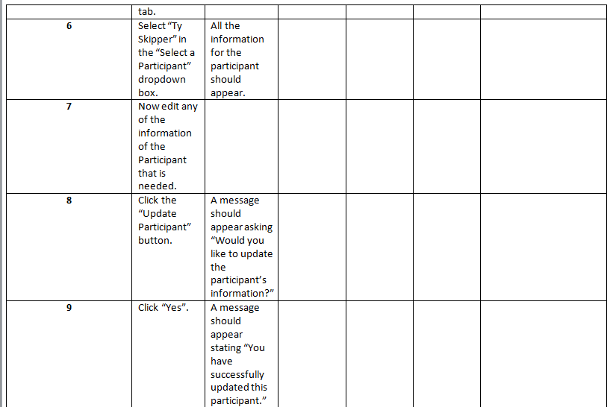
Notes:
Antonio

Slide 4
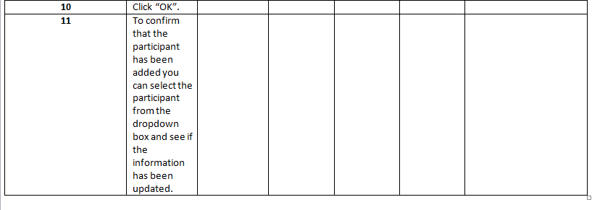
Notes:
Antonio

Slide 5
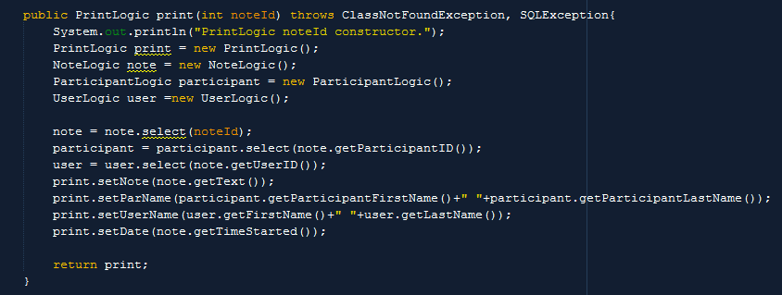
Code
i c i o u s
Notes:
Steven

Slide 6
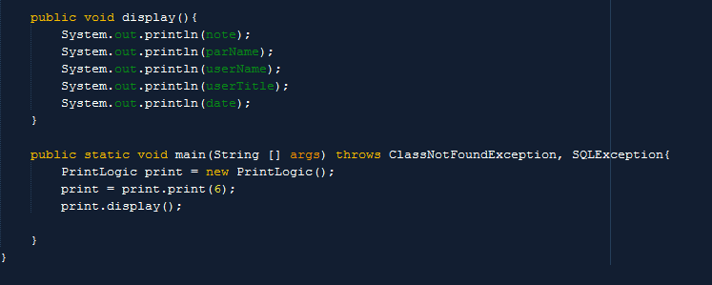
Code
i c i o u s
Notes:
Steven

Slide 7
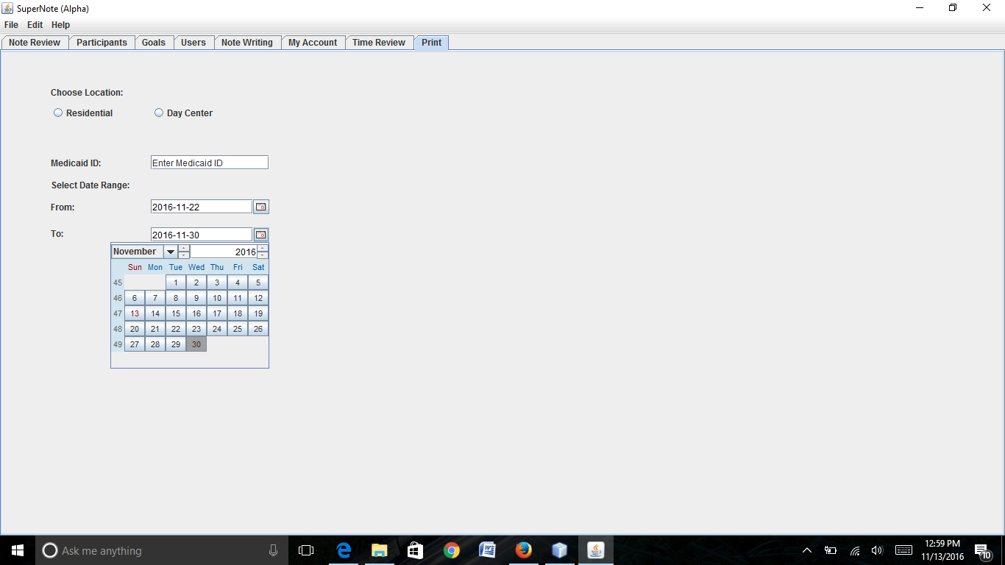
Deliverable
i c i o u s
Notes:
Rupa

Slide 8
Project Plan
i c i o u s
Continue building the PrintLogic class
Notes:
Zach

Slide 9
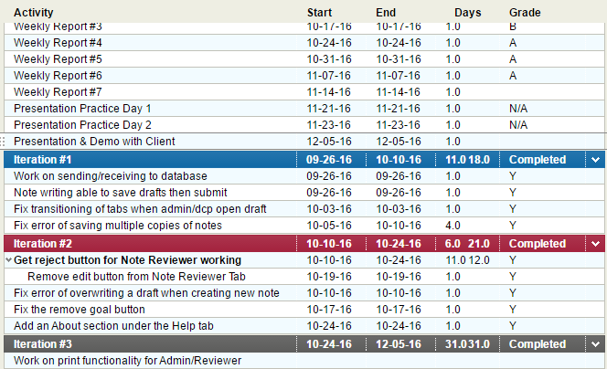
Project Plan for the Semester
Notes:
Ty

